Slide 1



WELCOME
TO OUR PROJECT
PRESENTATION
Conference-Website
Team Name: Data Pirates

Slide 2
Meet Out Teammate
Nafiur Rahman Sabbir
221-15-5871
Adnan Rony
221-15-5155

Slide 3



Introduction
The Conference Website project aims to create an online platform that facilitates seamless organization and participation in conferences. The website is designed to provide a user-friendly experience for both organizers and attendees, offering features such as event schedules, speaker information, registration, and interactive communication tools

Slide 4



Project Overview
The development of the Conference Website involved overcoming various challenges, including designing a responsive and visually appealing interface, implementing secure registration systems, and integrating real-time communication tools. Throughout the project, an iterative development approach was adopted, incorporating feedback from stakeholders to enhance the user experience.
In conclusion, the Conference Website serves as a comprehensive solution for modern conference management, addressing the needs of both organizers and attendees. The platform's success lies in its ability to streamline business processes, provide valuable information, and foster interactive communication within the conference community.

Slide 5

OBjective
The primary objectives of the Conference Website project include:
User-Friendly Interface: Develop an intuitive and easy-to-navigate interface for organizers and attendees.
Event Management: Implement features for creating, editing, and managing conference events.
Speaker Information: Provide a platform for organizers to showcase speaker profiles and allow attendees to access relevant information.
Registration System: Develop a secure and efficient registration system for conference participants.
Communication Tools: Integrate interactive communication tools, such as discussion forums and chat functionalities.

Slide 6
Implimentatation:
The technology used as follow:
HTML
TAILWIND CSS
JS
REACT JS

Slide 7
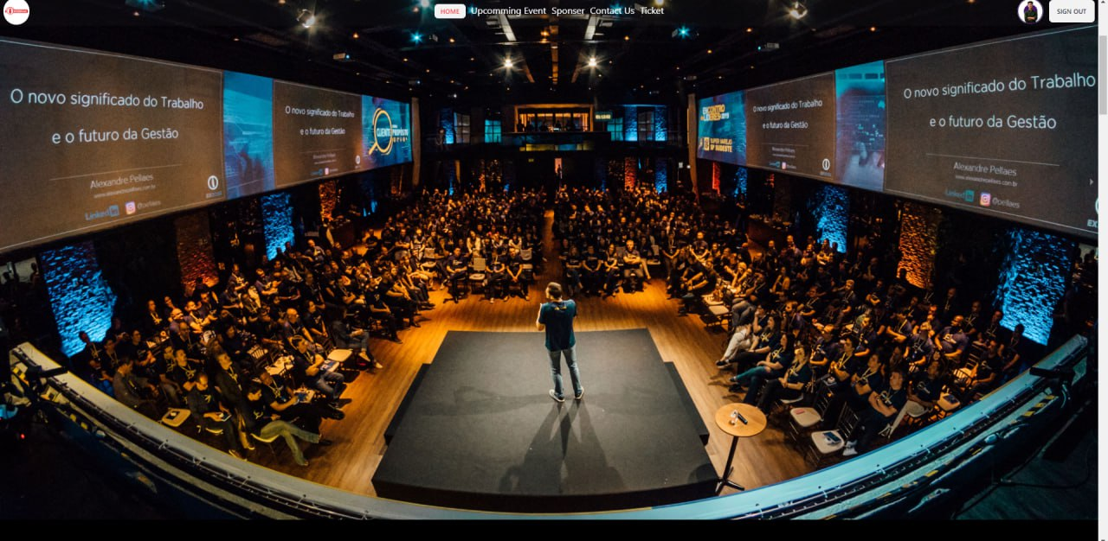
Home Page:
Nav-Bar

Slide 8
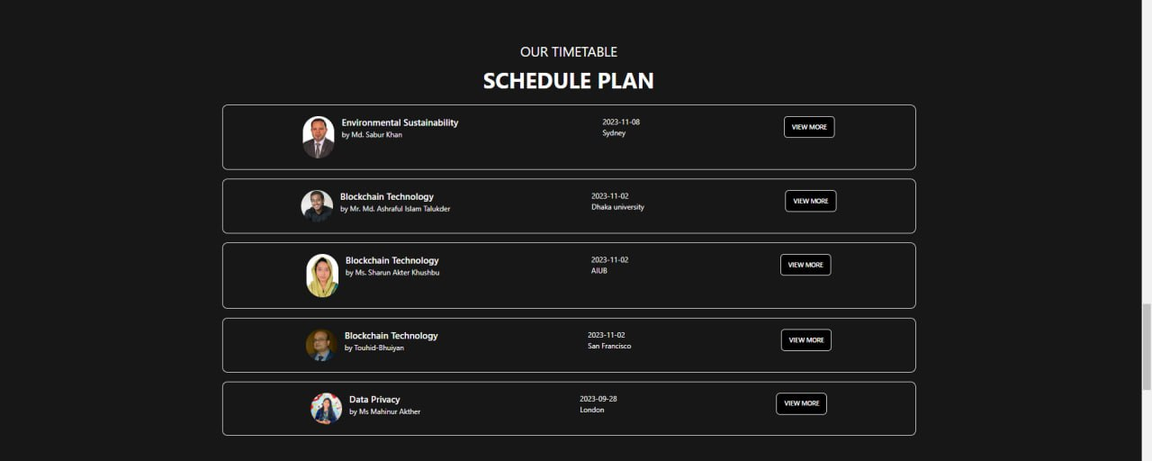
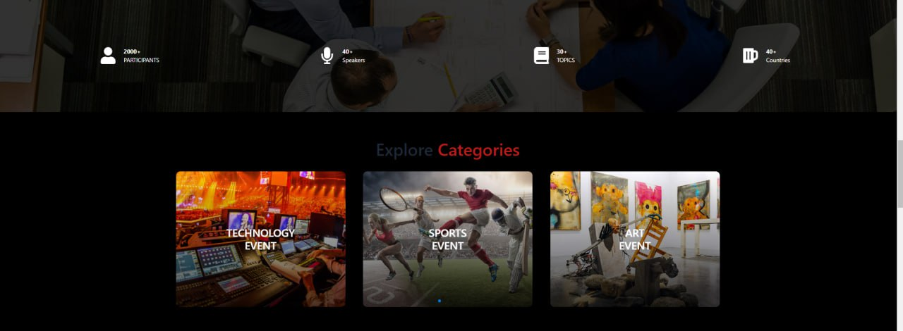
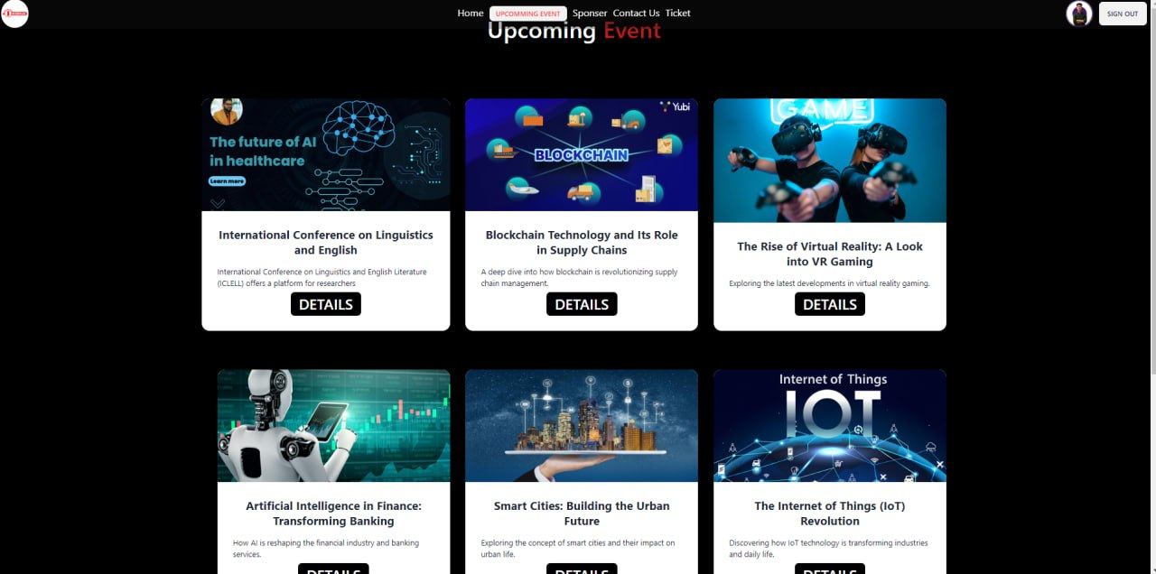
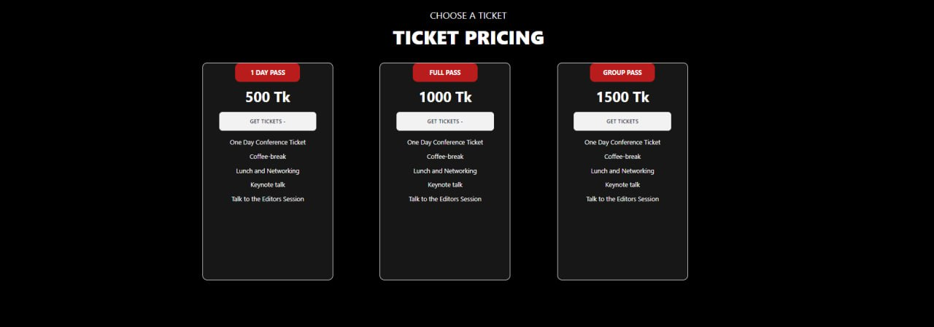
Some Web-page Segments Demo:

Slide 9
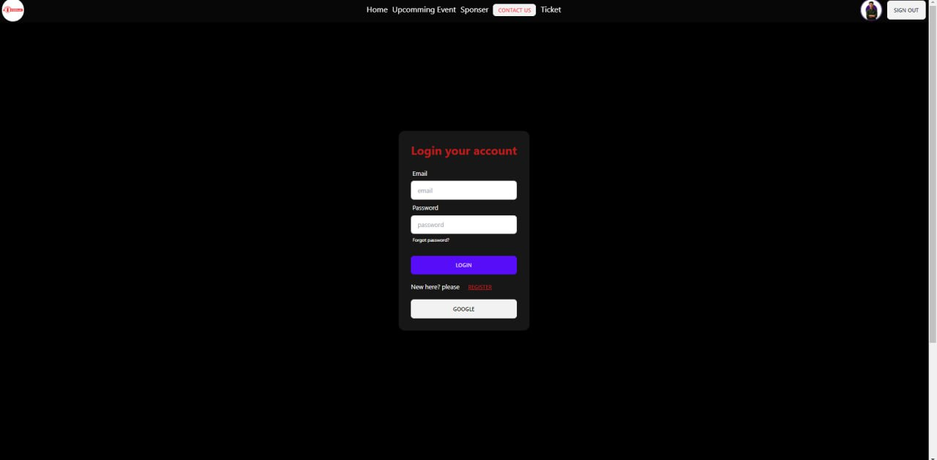
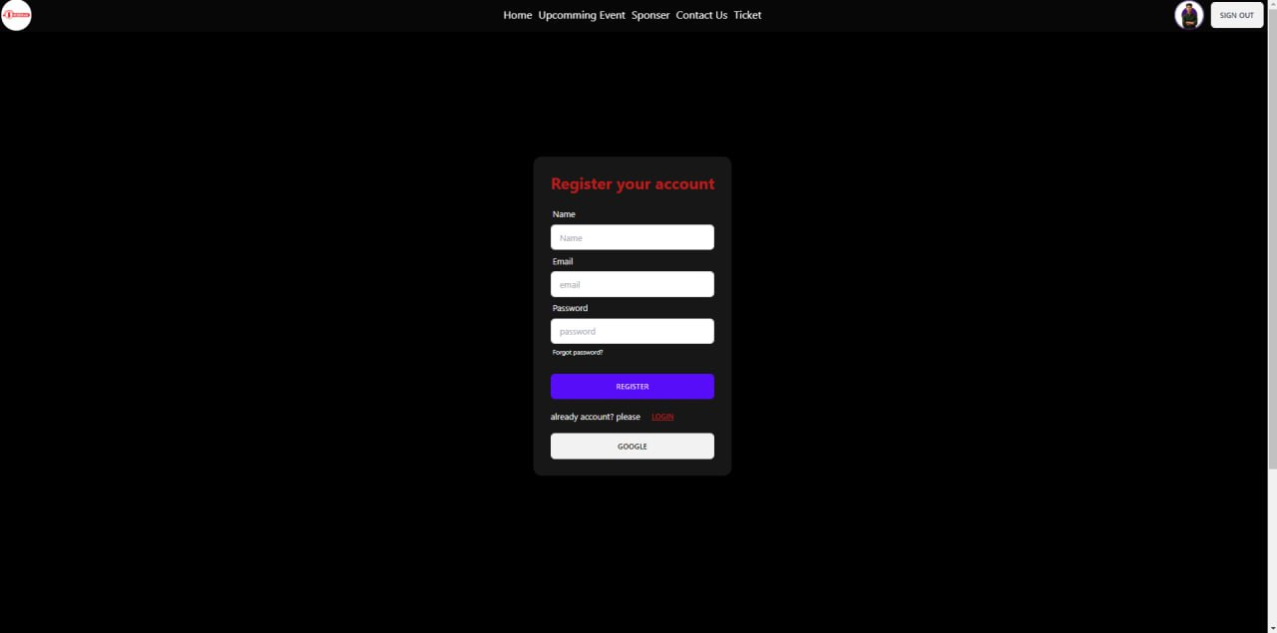
Log in & Registation

Slide 10


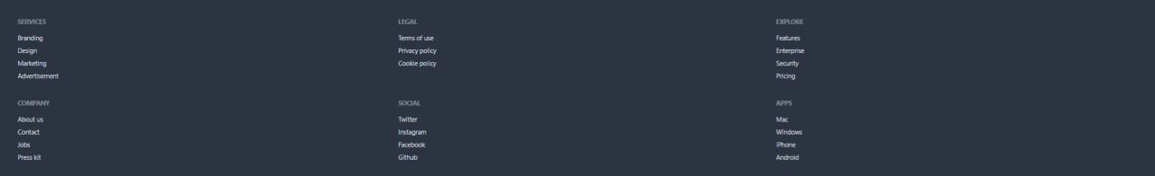

Slide 11


Thank You

